Slide 1

Brazil housing ----------------------case study
Shanmugaiya Pandian.V

Slide 2


Agenda
Objective
Tools
Graphs
Interpretation
Recommendation

Slide 3


objective
São Paulo And Porto Alegre Most Expensive city. They want to move less amount of city with same facility.
Castro Brazila Inc., a top real estate management firm with a nationwide presence in Brazil wishes to help people choose an alternate city to relocate to.
As a data analyst, help the firm figure out suitable cities for relocation for bachelors, for mid-sized families, and for large families.

Slide 4


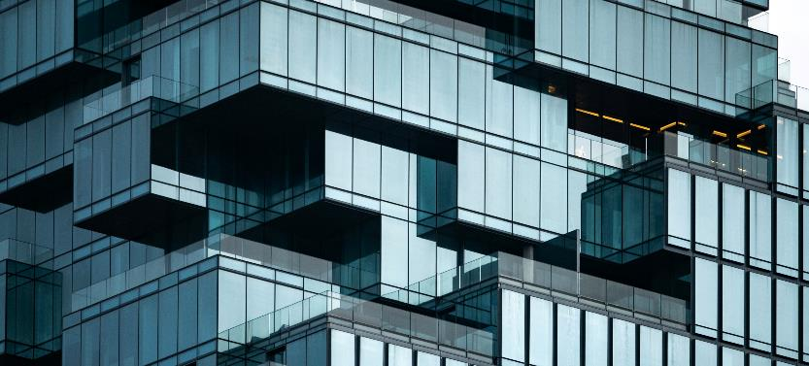
* Python * Library. * Pre defined functions. * Loops (if, for)
Tools

Slide 5
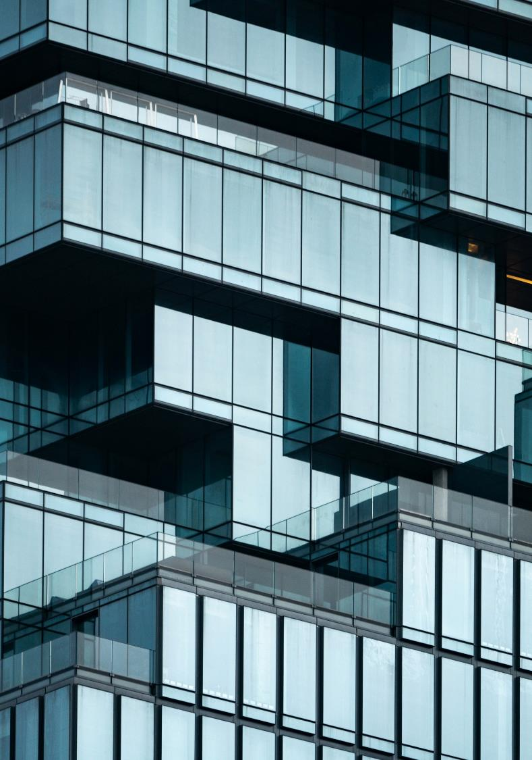
Analysis The Data(File)
Read The File Using Pandas Library
Check The Rows and Columns -- 10692 rows and 13 columns
Check The Null Values – No Null Values Present In The file.
Separate the columns Categorical and Numerical
Missing Value Treatment
Import All Library

Slide 6
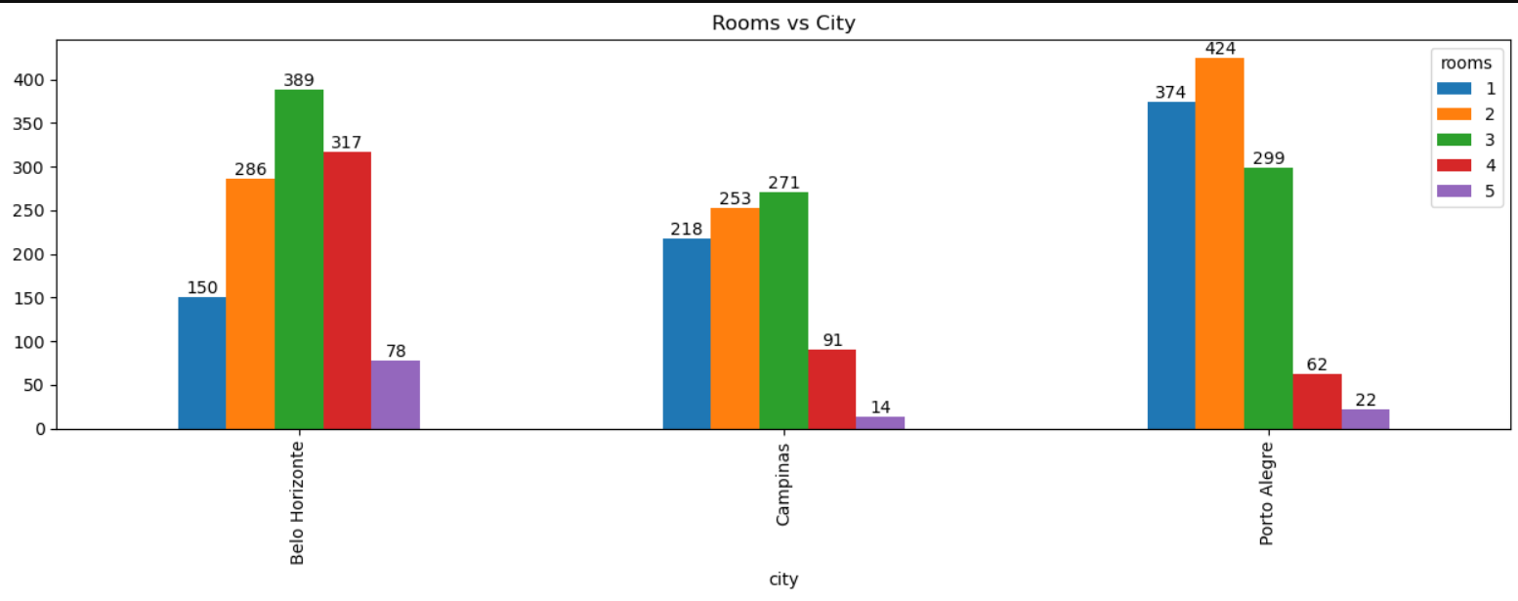
Which CITY have lot of rooms
1 AND 2 ROOMS AVAILABLE IN PORTO ALEGRE
3,4 and 5 ROOMS AVAILABLE IN BELO HORIZONTE

Slide 7
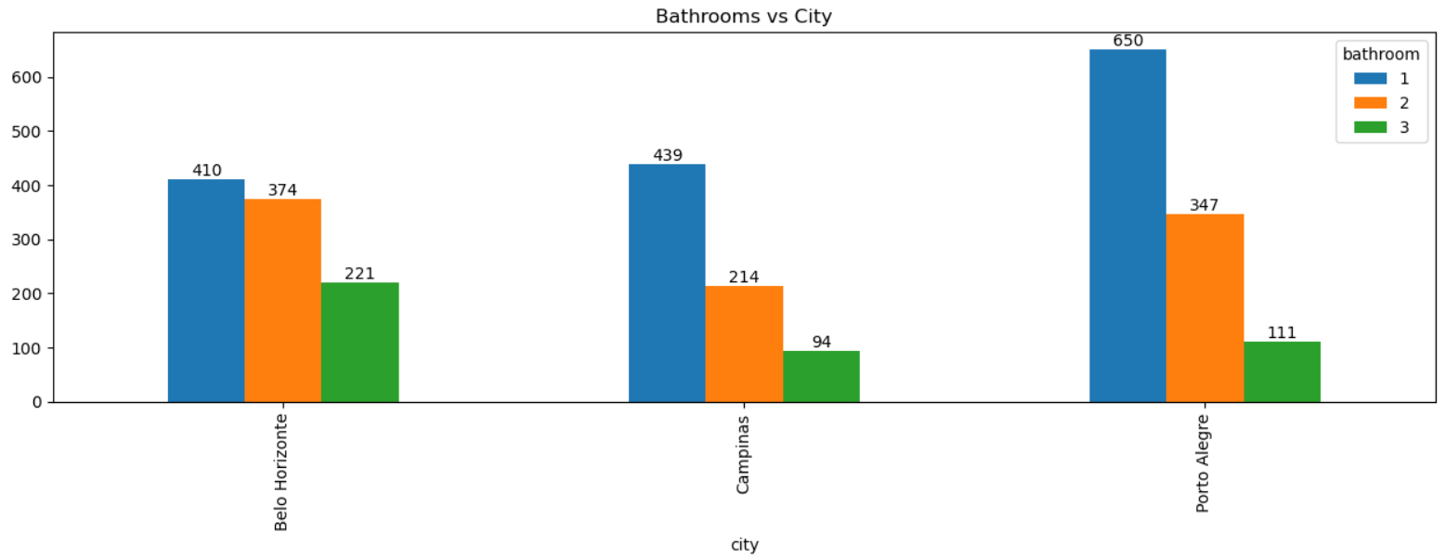
Which city have lot of bathrooms
1 BATHROOMS AVAILABLE IN PORTO ALEGRE
2 AND 3 BATHROOMS AVAILABLE IN BELO HORIZONTE

Slide 8
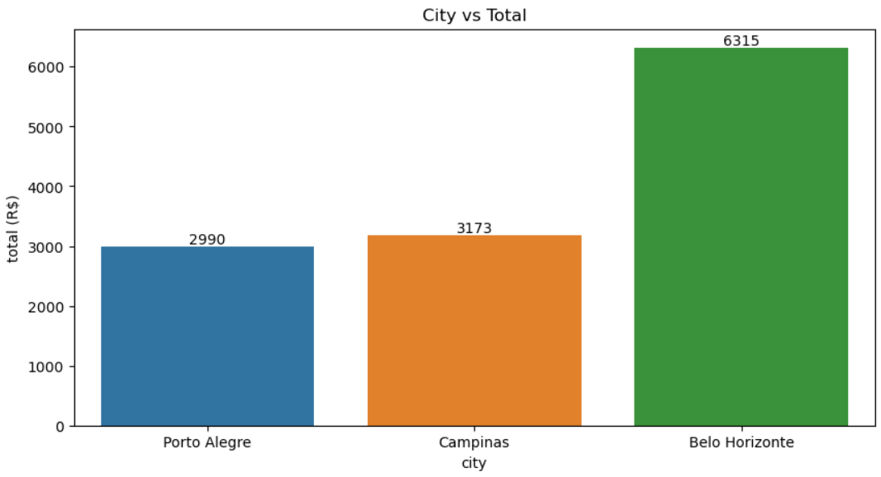
Which city have lowest average rent
PORTO ALEGRE AND BELO HORRZONTIE HAVE LESS AMOUNT OF AVERAGE RENT

Slide 9
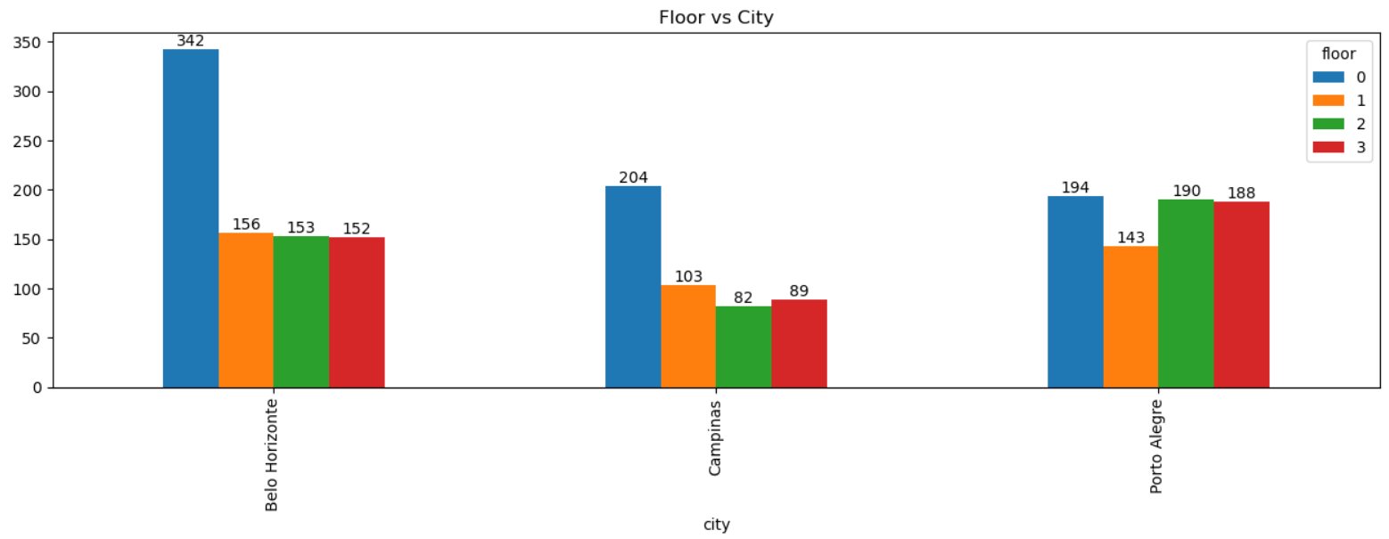
How many flat available floor-wise
1 and 2 FLOOR ENOUGH IN BELO HORIZONTE.
3 and 4 FOR PORTO ALGEGRE

Slide 10
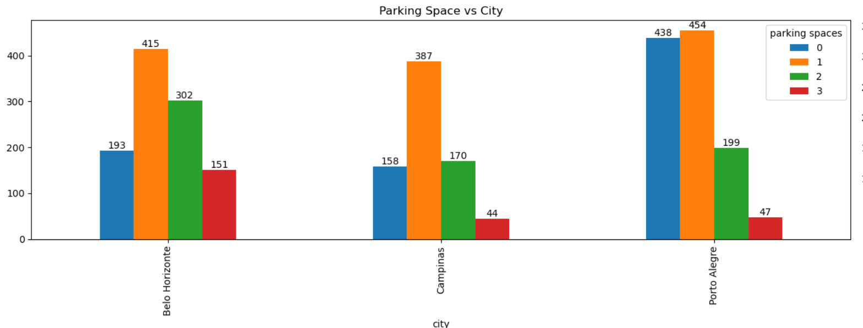
Which city have lot of parking space
1 and 2 PARKING SPACE ENOUGH IN PORTO ALGEGRE.
3 and 4 FOR BELO HORIZONTE

Slide 11
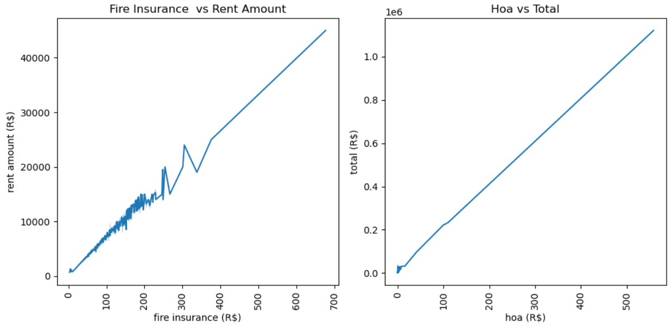
Which factors affect the tent & total
IF FIRE INSURANCE INCREASE RENT ALSO INCREASE
IF HOA ALSO INCREASE TOTAL ALSO INCREASE.

Slide 12
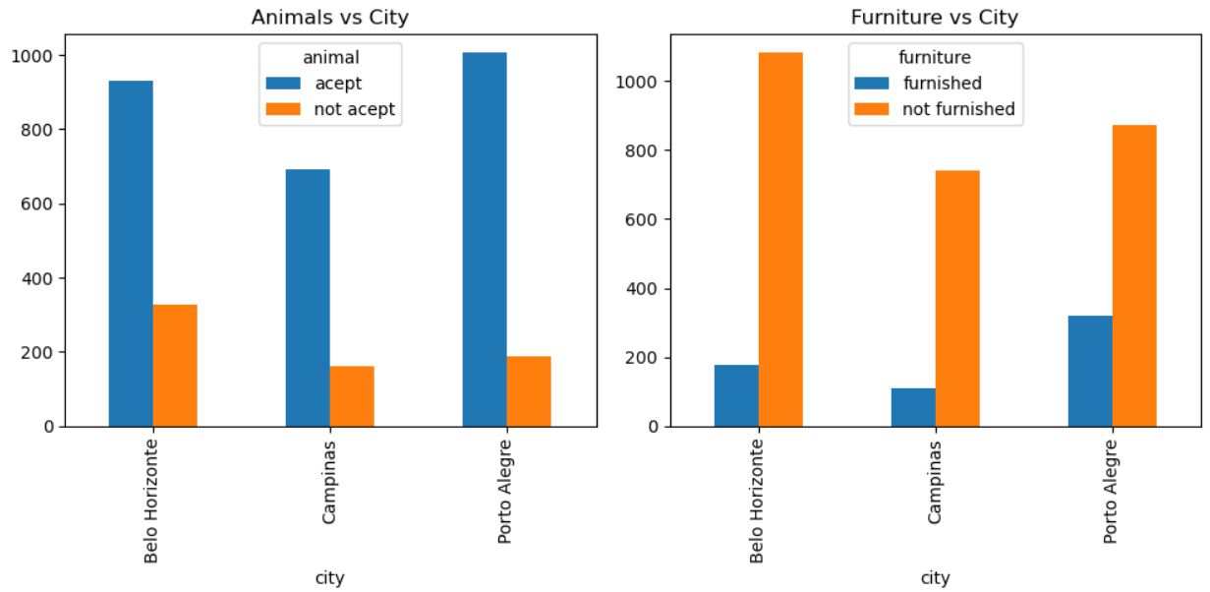
Is all flats animal accepted & furniture
IN PORTO ALEGRE AND BELO HORIZONTE ARE ACCEPT THE PETS.
IN PORTO ALEGRE AND BELO HORIZONTE ARE FURNISHED.

Slide 13
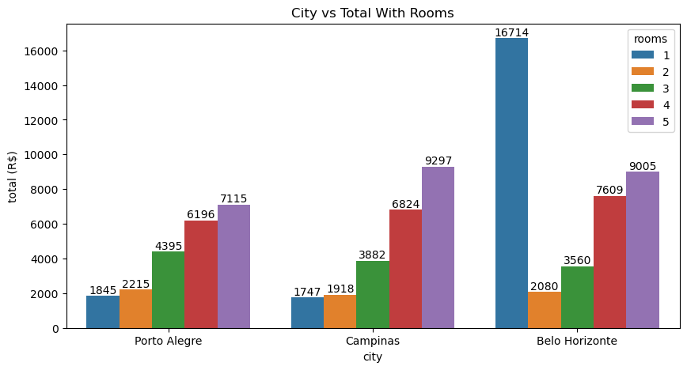
What is the average Total in rooms wise
In Campinas 1,2,3 rooms average total are low
In porto alegre 4 and 5 rooms are less average total.

Slide 14
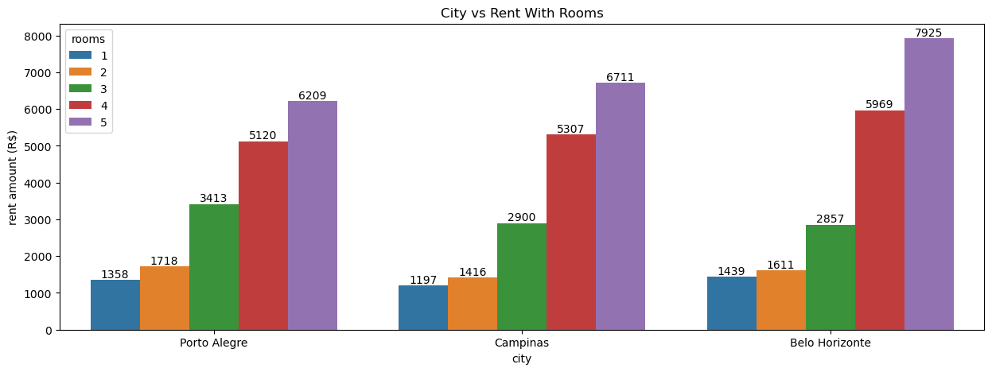
What is the average rent in rooms wise
In Campinas 1,2,3 rooms average rents are low
In porto alegre 4 and 5 rooms are less average rents.

Slide 15
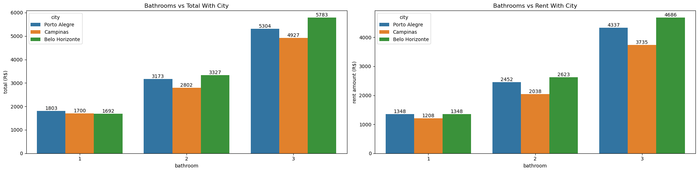
What is the total bathrooms wish
One Bathroom houses are low Total in Campinas and Belo Horizonte.
Two Bathroom houses are less total in Campinas.
Three Bathroom houses are less total in Campinas.

Slide 16
What is the Rent bathrooms wish
One bathroom Rent low in Campinas.
Two bathroom Rent low in Campinas.
Three bathroom Rent low in Campinas.

Slide 17
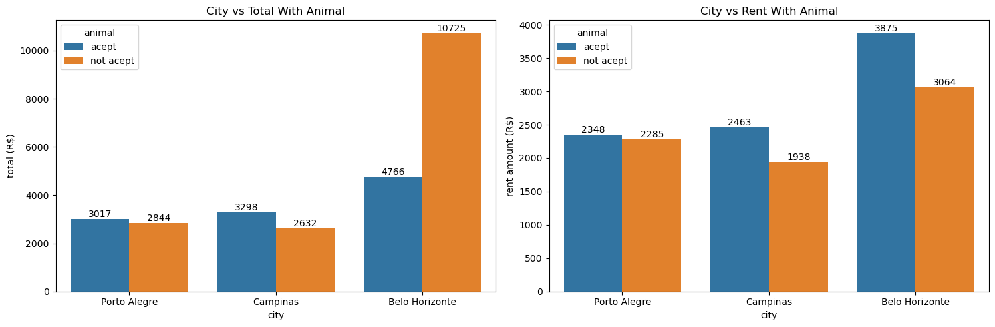
What is the average total and rent if animal accept
In the Porto alegre and Campinas not accept the pets are Average Total price less and in Belo Horizonte accept pets houses are less average rent.
In rent not accept pets houses are less rent.
if you have pets porto alegre best otherwise you dont have pet you will move to campinas.

Slide 18
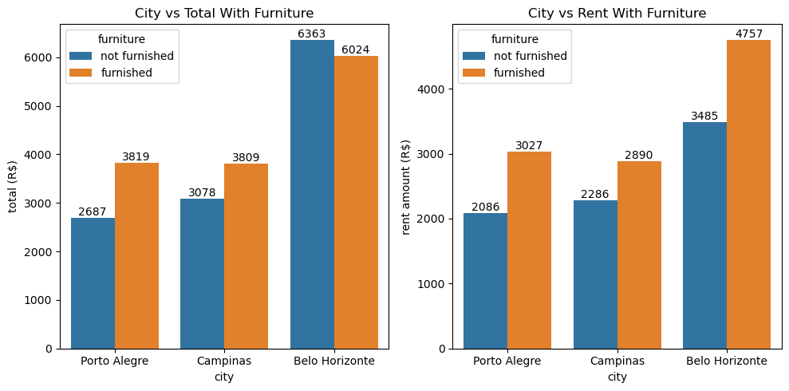
What is the average total and rent furniture and not furniture flats
In the Porto alegre and Campinas not furnished houses are Average Total price less and in Belo Horizonte furnished houses are less average total.
In the Porto alegre and Campinas not furnished houses are Average rent less and in Belo Horizonte furnished houses are less average rent.

Slide 19
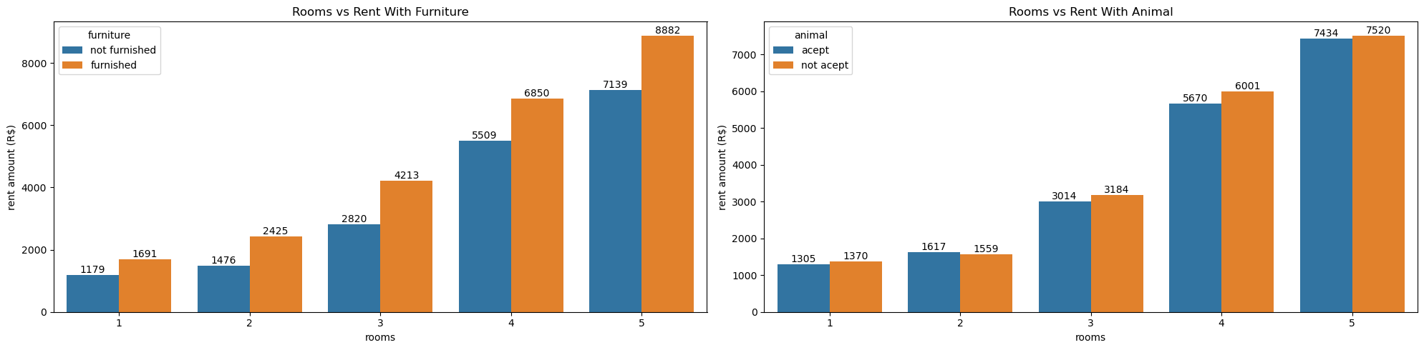
Rooms wise rent furniture and animals
If rooms increases rent also increases.
Animals doesn't affect the rent.

Slide 20
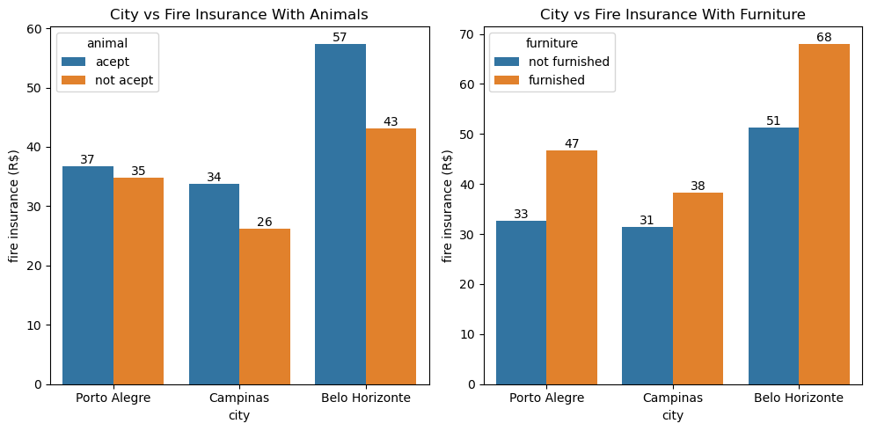
Is animal and furniture affect the fire insurance
In Porto Alegre ,animal not affect the fire insurange price.But remaining 2 cities if pets accept fire insurance increase.
In campinas only , furnished affect the fire insurance least.

Slide 21
Brazil housing
Interpretation -1
In The Porto Alegre And Campinas Not Accept The Pets Are Average Total Price Less And In Belo Horizonte Accept Pets Houses Are Less Average Rent. If You Have Pets Porto Alegre Best Otherwise You Don't Have Pet You Will Move To Campinas.
In Rent Not Accept Pets Houses Are Less Rent.
In The Porto Alegre And Campinas Not Furnished Houses Are Average Total Price Less And In Belo Horizonte Furnished Houses Are Less Average Total.
In The Porto Alegre And Campinas Not Furnished Houses Are Average Rent Less And In Belo Horizonte Furnished Houses Are Less Average Rent.
In Porto Alegre ,Animal Not Affect The Fire Insurance Price .but Remaining 2 Cities If Pets Accept Fire Insurance Increase.
if Rooms Increases Rent Also Increases.
Animals Doesn't Affect The Rent.
In Campinas Only , Furnished Affect The Fire Insurance Least.
Rooms Increases Rent Amount Also Increases. Compare To Not Furnished , Furnished Houses Are Rent High.
Porto Alegre Is Not Furnished House Rent Low And In Campinas Furnished House Are Rent Low.
0 And 1 Parking Space Are Total Amount Is Same. So Wee Take The 1 Parking Space Houses. 2 And 3 Parking Space Houses In Campinas Is Less Total.
0 And 1 Parking Space Are Rent Amount Is Same. So Wee Take The 1 Parking Space Houses In Campinas. 2 And 3 Parking Space Houses In Campinas Is Less Total.
In Campinas 1,2,3 Rooms Average Total Are Low And In Porto Alegre 4 And 5 Rooms Are Less Average Total.
In Campinas 1,2,3 Rooms Average Rents Are Low And In Porto Alegre 4 And 5 Rooms Are Less Average Rents
One Bathroom Houses Are Low Total In Campinas And Belo Horizonte.
Bathroom Houses Are Less Total In Campinas.
Three Bathroom Houses Are Less Total In Campinas.
One Bathroom Rent Low In Campinas.
Two Bathroom Rent Low In Campinas.
Three Bathroom Rent Low In Campinas.
One Bathroom And 2 Rooms Are Less Average Total. Two Bathroom And 2 Rooms Are Less Average Total. Three Bathroom And 3 Rooms Are Less Average Total.1 Bathroom With 1 And 2 Room Are Less Average Rent. 1 Bathroom With 1 And 2 Room Are Less Average Rent. 3 Bathroom With 2 And 3 Room Are Less Average Rent.

Slide 22
Brazil housing
One Room
Two rooms
Three rooms
For one room - Average total in Campinas is less(1747).
For one room - Average rent in Campinas is less(1197).
For one room - Average rent with furnished is 1691.
For one room - Average rent with not furnished 1179..
For one room - Average rent with animal 1305.
For one room - Average rent with not animal 1370.
* For two room - Average total in Campinas is less(1918).
For two room - Average rent in Campinas is less(1416).
For two room - Average rent with furnished is 2425.
For two room - Average rent with not furnished 1476.
For two room - Average rent with animal 1617.
For two room - Average rent with not animal 1559.
For Three room - Average total in Belo Horizonte is less(3560).
For Three room - Average rent in Belo Horizonte is less(2857).
For Three room - Average rent with furnished is 4213.
For Three room - Average rent with not furnished 2820.
For Three room - Average rent with animal 3014.
For Three room - Average rent with not animal 3184.

Slide 23

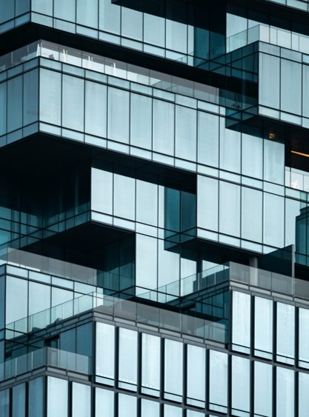


Recommendation
WE CONSIDER FOR BACHELOR ENOUGH ONE ROOM ,ONE PARKING SPACE,ONE BATHROOM
WE CONSIDER FOR MID-SIZE FAMILY ENOUGH 2 ,ONE OR TWO PARKING SPACE,ONE OR 2 BATHROOM
WE CONSIDER THE ABOVE 3 ROOMS AND ABOVE THREE PARKING AND ABOVE 2 BATHROOMS
MID-SIZE FAMILY
LARGE FAMILY
BACHELOR

Slide 24
Recommendation
CAMPINAS BEST FOR BACHELOR.
Average total in Campinas is less(1747).
Average rent in Campinas is less(1197).
Average rent with furnished is 1691.
*Average rent with not furnished 1179.
Average rent with animal 1305.
Average rent with not animal 1370.

Slide 25
Recommendation
CAMPINAS BEST FOR MID_SIZE FAMILY.
Average total in Campinas is less(1918).
Average rent in Campinas is less(1416).
Average rent with furnished is 2425.
Average rent with not furnished 1476.
Average rent with animal 1617.
Average rent with not animal 1559.

Slide 26
Recommendation
BELO HORIZONTE BEST FOR LARGE FAMILY.ROOMS INCREASE RENT ALSO INCREASE.
Average total in Belo Horizonte is less(3560).
Average rent in Belo Horizonte is less(2857).
Average rent with furnished is 4213.
Average rent with not furnished 2820.
Average rent with animal 3014.
Average rent with not animal 3184.

Slide 27

Thank you
Name : Shanmugaiya Pandian.V
Email : pandi200ns@gmail.com

